Slide 1
Sensing as a Service in 6G Perceptive Networks: A Unified Framework for ISAC Resource Allocation
Fuwang Dong , Member, IEEE, Fan Liu , Member, IEEE, Yuanhao Cui , Member, IEEE, Wei Wang , Senior Member, IEEE, Kaifeng Han , Member, IEEE, and Zhiqin Wang

Slide 2
Table of Contents

Slide 3

PCRB for Tracking or Filtering
Purpose Of These Slides
  Topic:
    $\text{PCRB} \text{for} \text{nonlinear} \text{filtering}$
  Goal:
    $\text{Understand} \text{how} \text{posterior} \text{Fisher} \text{information} J_{n} \text{is} \text{derived}$
  Main path:
    $\text{Measurement} \text{model}→\text{Score} \text{function}→\text{Fisher} \text{information}→\text{Posterior} \text{information}→\text{Recursive} \text{PCRB}→\text{Kalman}\text{/}\text{EKF} \text{connection}$

Slide 4

PCRB for Tracking or Filtering
Estimation Problem
  Suppose measurement/data is:
    $X$
  Unknown parameter/state is:
    $θ$
  The estimation problem is:
    $X→\hat{θ}$
  Main question:
    $\text{How} \text{much} \text{information} \text{does} X \text{give} \text{about} θ?$
    This information determines the minimum possible estimation error.

Slide 5
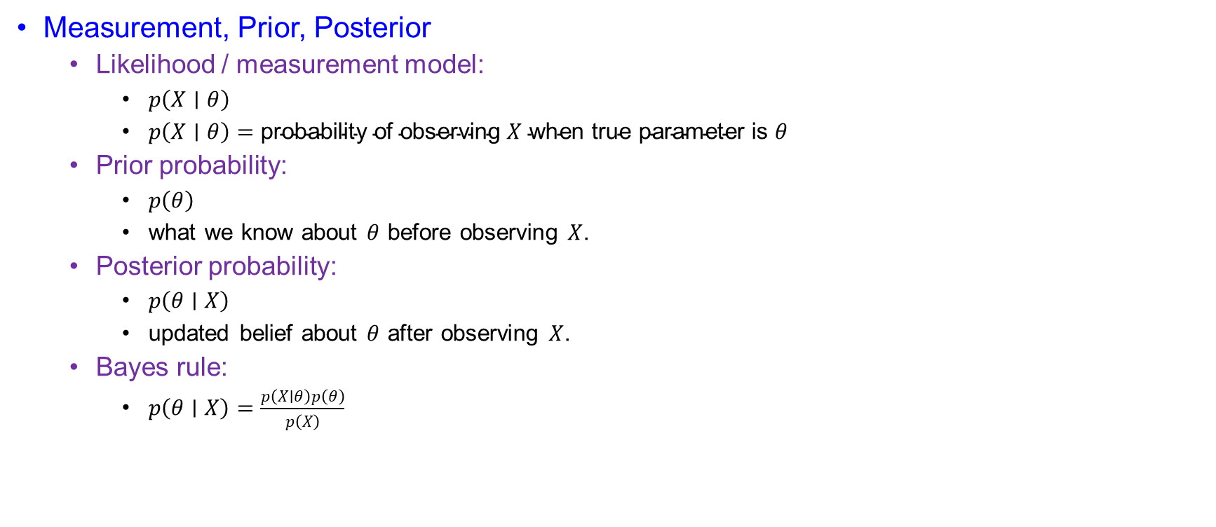
PCRB for Tracking or Filtering
Measurement, Prior, Posterior
  Likelihood / measurement model:
    $p\left(X∣θ\right)$
    $p\left(X∣θ\right)=\text{probability} \text{of} \text{observing} X \text{when} \text{true} \text{parameter} \text{is} θ$
  Prior probability:
    $p\left(θ\right)$
    what we know about $θ$ before observing $X$.
  Posterior probability:
    $p\left(θ∣X\right)$
    updated belief about $θ$ after observing $X$.
  Bayes rule:
    $p\left(θ∣X\right)=\frac{p\left(X∣θ\right)p\left(θ\right)}{p\left(X\right)}$

Slide 6

PCRB for Tracking or Filtering
Why A Derivative Appears
  If the parameter changes slightly:
    $θ→θ+dθ$
  then the likelihood changes:
    $p\left(X∣θ\right)→p\left(X∣θ+dθ\right)$
  So, we check sensitivity:
    $\frac{∂p\left(X∣θ\right)}{∂θ}$
  This tells how sensitive the probability model is to the parameter.

Slide 7

PCRB for Tracking or Filtering
Relative Change And Score Function
  Instead of raw change, use relative change:
    $\frac{1}{p\left(X∣θ\right)}\frac{∂p\left(X∣θ\right)}{∂θ}$
  Using log rule:
    $\frac{1}{p\left(X∣θ\right)}\frac{∂p\left(X∣θ\right)}{∂θ}=\frac{∂}{∂θ}\log{p}\left(X∣θ\right)$
  So, the score function is:
    $s(X,θ)=\frac{∂}{∂θ}\log{p}\left(X∣θ\right)$
  $\text{Score} \text{function}\text{ = }\text{relative} \text{slope} \text{of} \text{the} \text{likelihood}$

Slide 8
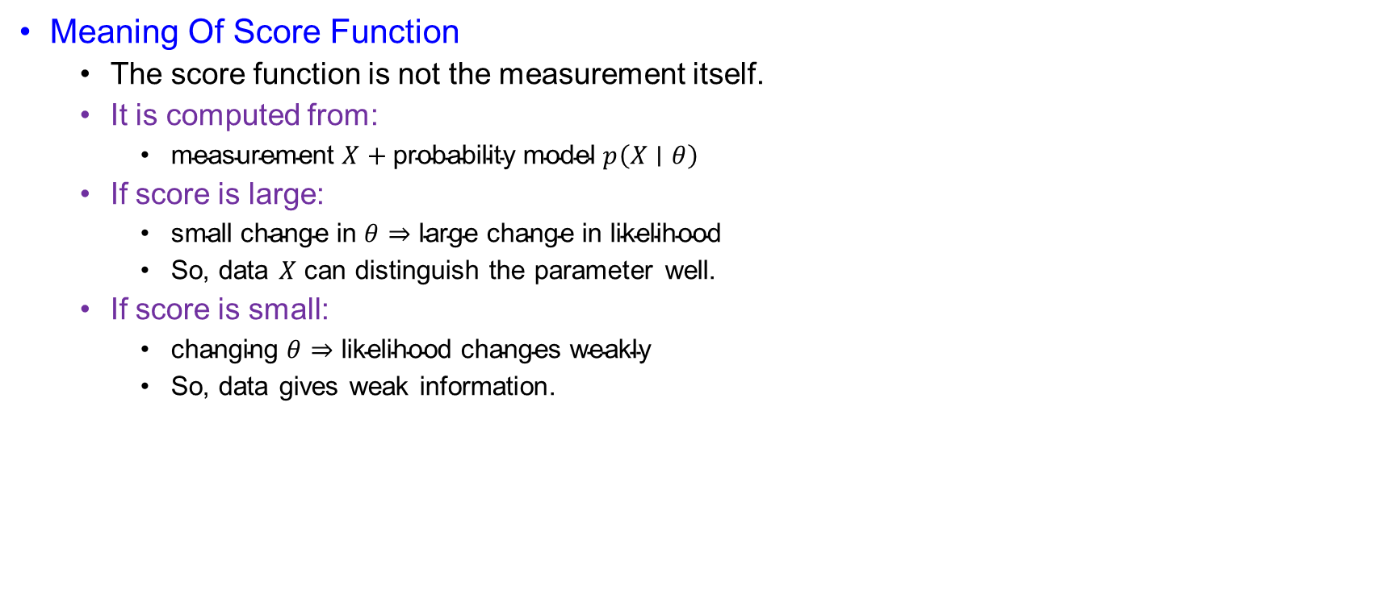
PCRB for Tracking or Filtering
Meaning Of Score Function
  The score function is not the measurement itself.
  It is computed from:
    $\text{measurement} X+\text{probability} \text{model} p\left(X∣θ\right)$
  If score is large:
    $\text{small} \text{change} \text{in} θ⇒\text{large} \text{change} \text{in} \text{likelihood}$
    So, data $X$ can distinguish the parameter well.
  If score is small:
    $\text{changing} θ⇒\text{likelihood} \text{changes} \text{weakly}$
    So, data gives weak information.

Slide 9
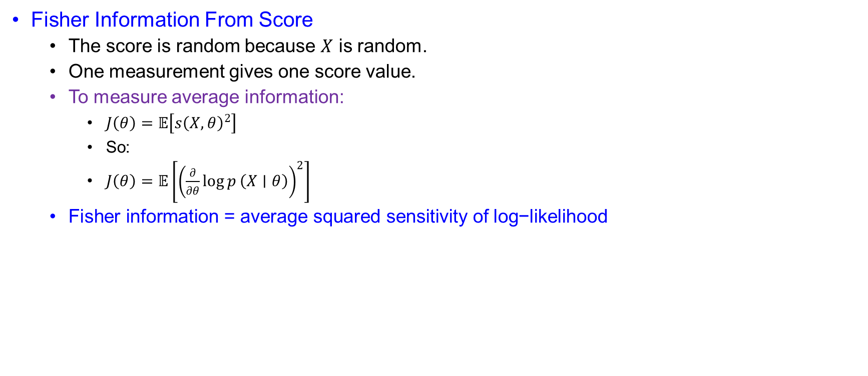
PCRB for Tracking or Filtering
Fisher Information From Score
  The score is random because $X$ is random.
  One measurement gives one score value.
  To measure average information:
    $J\left(θ\right)=𝔼\left[s{\left(X,θ\right)}^{2}\right]$
    So:
    $J\left(θ\right)=𝔼\left[{\left(\frac{∂}{∂θ}\log{p}\left(X∣θ\right)\right)}^{2}\right]$
  $\text{Fisher} \text{information}\text{ = }\text{average} \text{squared} \text{sensitivity} \text{of} \text{log}\text{−}\text{likelihood}$

Slide 10
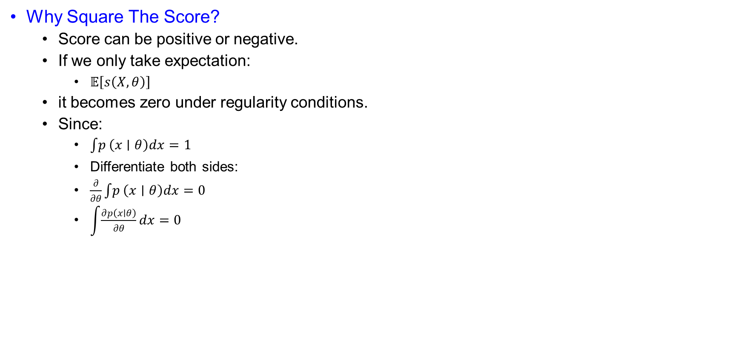
PCRB for Tracking or Filtering
Why Square The Score?
  Score can be positive or negative.
  If we only take expectation:
    $𝔼\left[s\left(X,θ\right)\right]$
  it becomes zero under regularity conditions.
  Since:
    $\int{p}\left(x∣θ\right)dx=1$
    Differentiate both sides:
    $\frac{∂}{∂θ}\int{p}\left(x∣θ\right)dx=0$
    $\int{\frac{∂p\left(x∣θ\right)}{∂θ}}dx=0$

Slide 11

PCRB for Tracking or Filtering
Average Score Is Zero
  $𝔼\left[s\left(X,θ\right)\right]=\int{\frac{∂\log{p}\left(x∣θ\right)}{∂θ}}p\left(x∣θ\right)dx$
  $=\int{\frac{1}{p\left(x∣θ\right)}}\frac{∂p\left(x∣θ\right)}{∂θ}p\left(x∣θ\right)dx$
  $=\int{\frac{∂p\left(x∣θ\right)}{∂θ}}dx$
  $=0$
  Therefore:
    $𝔼\left[s\left(X,θ\right)\right]=0$
  So, we use:
    $𝔼\left[s^{2}\right]$
  instead of:
    $𝔼\left[s\right]$

Slide 12
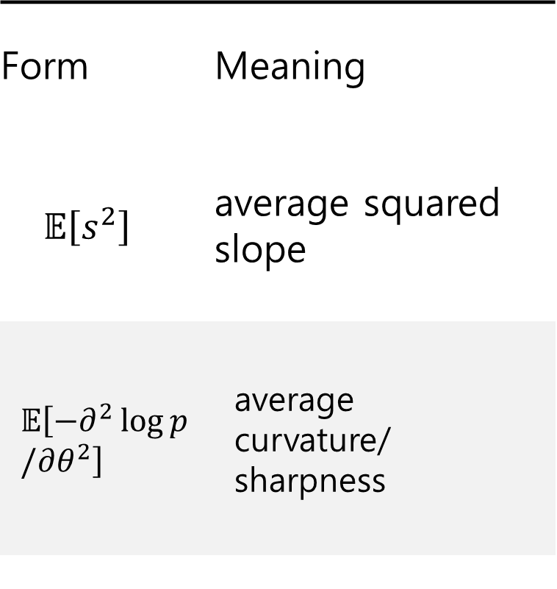
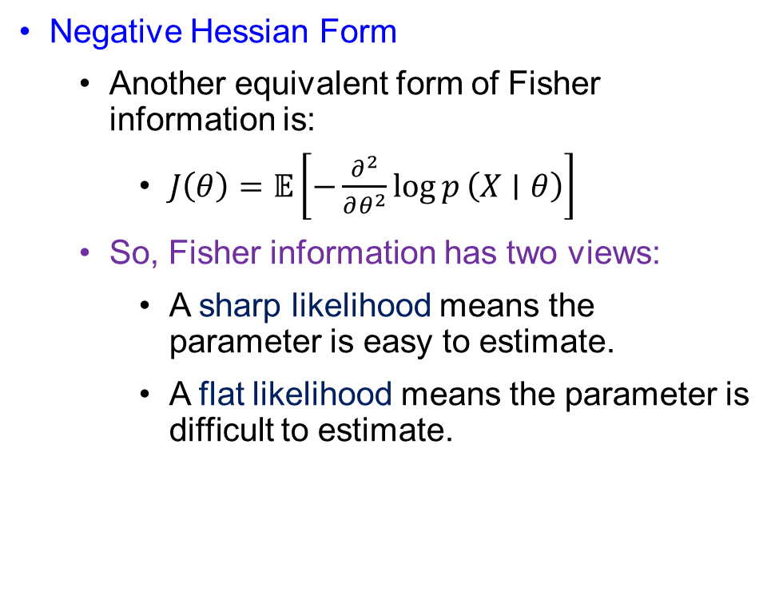
PCRB for Tracking or Filtering
Negative Hessian Form
  Another equivalent form of Fisher information is:
    $J\left(θ\right)=𝔼\left[−\frac{∂^{2}}{∂θ^{2}}\log{p}\left(X∣θ\right)\right]$
  So, Fisher information has two views:
    A sharp likelihood means the parameter is easy to estimate.
    A flat likelihood means the parameter is difficult to estimate.
Form | Meaning
$$𝔼\left[s^{2}\right]$$ | average squared slope
$$𝔼\left[−∂^{2}\log{p}/∂θ^{2}\right]$$ | average curvature/ sharpness

Slide 13

PCRB for Tracking or Filtering
Vector Fisher Information
  For random parameter vector:
    $Θ={\left[Θ_{1},Θ_{2},……,Θ_{r}\right]}^{T}$
  Score component:
    $s_{i}(X,Θ)=\frac{∂}{∂Θ_{i}}\log{p_{X,Θ}}\left(X,Θ\right)$
    $=\frac{1}{p_{X,Θ}\left(X,Θ\right)}\frac{∂p_{X,Θ}\left(X,Θ\right)}{∂Θ_{i}}$
  Fisher information matrix:
    $J_{ij}=𝔼\left[s_{i}\left(X,Θ\right)s_{j}\left(X,Θ\right)\right]$
    $J_{ij}=𝔼\left[\frac{∂\log{p_{X,Θ}}\left(X,Θ\right)}{∂Θ_{i}}\frac{∂\log{p_{X,Θ}}\left(X,Θ\right)}{∂Θ_{j}}\right]$

Slide 14

PCRB for Tracking or Filtering
Negative Hessian Derivation
  Let:
    $p=p_{X,Θ}\left(X,Θ\right)$
  First derivative:
    $\frac{∂\log{p}}{∂Θ_{i}}=\frac{1}{p}\frac{∂p}{∂Θ_{i}}$
  Second derivative:
    $\frac{∂^{2}\log{p}}{∂Θ_{i}∂Θ_{j}}=\frac{1}{p}\frac{∂^{2}p}{∂Θ_{i}∂Θ_{j}}−\frac{1}{p^{2}}\frac{∂p}{∂Θ_{i}}\frac{∂p}{∂Θ_{j}}$
  Taking expectation:
    $𝔼\left[\frac{∂^{2}\log{p}}{∂Θ_{i}∂Θ_{j}}\right]=\iint{\frac{∂^{2}p}{∂Θ_{i}∂Θ_{j}}}dXdΘ−\iint{\frac{1}{p}}\frac{∂p}{∂Θ_{i}}\frac{∂p}{∂Θ_{j}}dXdΘ$

Slide 15

PCRB for Tracking or Filtering
Why First Term Becomes Zero
  First term:
    $T_{1}=\iint{\frac{∂^{2}p}{∂Θ_{i}∂Θ_{j}}}dXdΘ$
  Write:
    $\frac{∂^{2}p}{∂Θ_{i}∂Θ_{j}}=\frac{∂}{∂Θ_{j}}\left(\frac{∂p}{∂Θ_{i}}\right)$
  Integrate over $Θ_{j}$:
    $\int_{−∞}^{∞}{\frac{∂}{∂Θ_{j}}}\left(\frac{∂p}{∂Θ_{i}}\right)dΘ_{j}={\left[\frac{∂p}{∂Θ_{i}}\right]}_{−∞}^{∞}$
  Under regularity condition:
    $\frac{∂p}{∂Θ_{i}}→0 \text{at} \text{boundary}$
  Therefore:
    $T_{1}=0$

Slide 16

PCRB for Tracking or Filtering
Final Fisher Information Identity
  Since the first term is zero:
    $𝔼\left[\frac{∂^{2}\log{p}}{∂Θ_{i}∂Θ_{j}}\right]=−\iint{\frac{1}{p}}\frac{∂p}{∂Θ_{i}}\frac{∂p}{∂Θ_{j}}dXdΘ$
  But:
    $\frac{∂\log{p}}{∂Θ_{i}}=\frac{1}{p}\frac{∂p}{∂Θ_{i}}$
  So:
    $𝔼\left[−\frac{∂^{2}\log{p}}{∂Θ_{i}∂Θ_{j}}\right]=𝔼\left[\frac{∂\log{p}}{∂Θ_{i}}\frac{∂\log{p}}{∂Θ_{j}}\right]$
  This proves:
    $\text{Negative} \text{Hessian} \text{form}=\text{Score} \text{outer}\text{−}\text{product} \text{form}$

Slide 17

PCRB for Tracking or Filtering
Posterior Information Decomposition
  For PCRB, $Θ$ is random.
  So, we use joint density:
    $p\left(X,Θ\right)$
  Bayes factorization:
    $p\left(X,Θ\right)=p\left(X∣Θ\right)p\left(Θ\right)$
  Taking log:
    $\log{p}\left(X,Θ\right)=\log{p}\left(X∣Θ\right)+\log{p}\left(Θ\right)$
  Therefore:
    $J=J_{D}+J_{P}$
  where:
    $J_{D}=𝔼\left[−Δ_{Θ}^{Θ}\log{p}\left(X∣Θ\right)\right]$
    $J_{P}=𝔼\left[−Δ_{Θ}^{Θ}\log{p}\left(Θ\right)\right]$

Slide 18

PCRB for Tracking or Filtering
Meaning Of $J_{D}$, $J_{P}$, And $J$
  $J_{D}=\text{information} \text{from} \text{measurements}$
  $J_{P}=\text{information} \text{from} \text{prior}$
  $J=\text{total} \text{posterior} \text{information}$
  Better measurements:
    $J_{D}↑$
  Stronger prior knowledge:
    $J_{P}↑$
  Larger posterior information:
    $J↑$
  Smaller PCRB:
    $J^{−1}↓$
  So:
    $PCRB=J^{−1}$

Slide 19
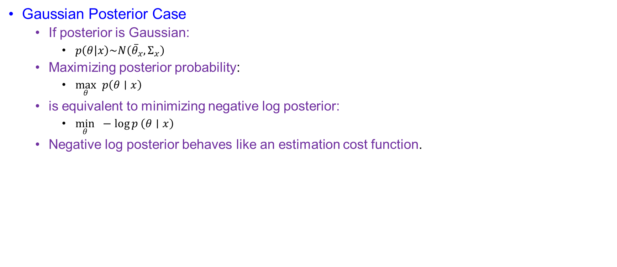
PCRB for Tracking or Filtering
Gaussian Posterior Case
  If posterior is Gaussian:
    $p\left(θ | x\right)\sim N\left({\overline{θ}}_{x},Σ_{x}\right)$
  Maximizing posterior probability:
    $\max_{θ} p\left(θ∣x\right)$
  is equivalent to minimizing negative log posterior:
    $\min_{θ} −\log{p}\left(θ∣x\right)$
  Negative log posterior behaves like an estimation cost function.

Slide 20
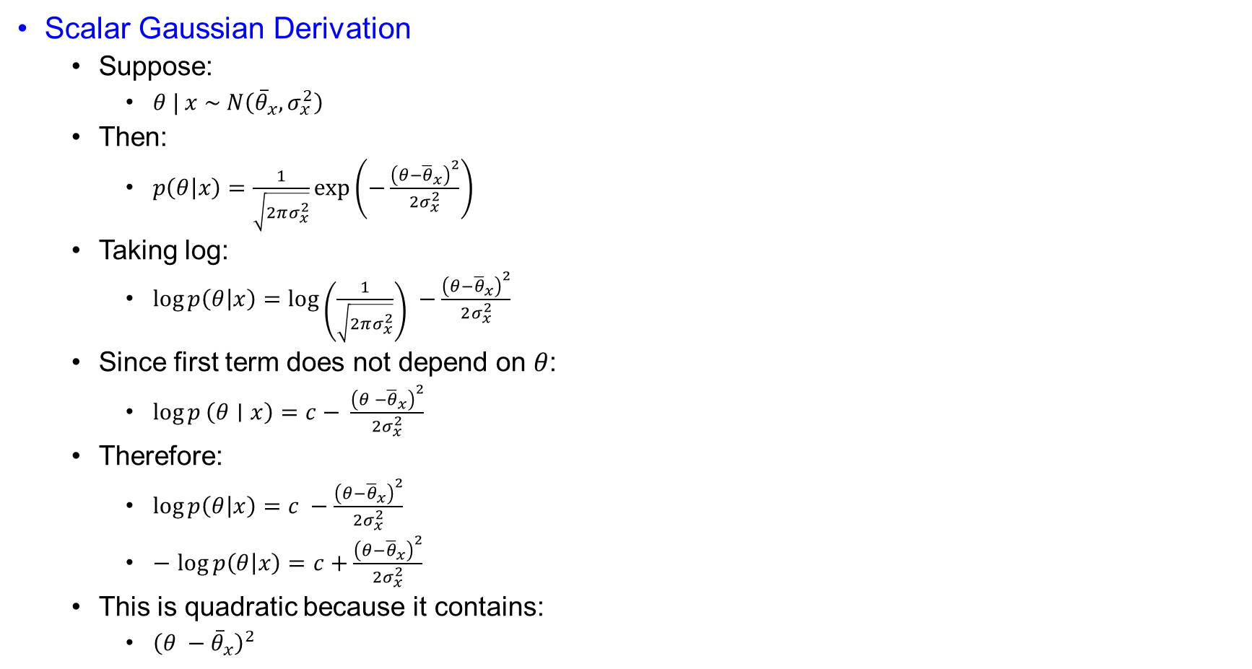
PCRB for Tracking or Filtering
Scalar Gaussian Derivation
  Suppose:
    $θ | x \sim N\left({\overline{θ}}_{x},σ_{x}^{2}\right)$
  Then:
    $p\left(θ | x\right)=\frac{1}{\sqrt{2πσ_{x}^{2}}}\exp\left(−\frac{{\left(θ−{\overline{θ}}_{x}\right)}^{2}}{2σ_{x}^{2}}\right)$
  Taking log:
    $\log{p\left(θ | x\right)}=\log\left(\frac{1}{\sqrt{2πσ_{x}^{2}}}\right) −\frac{{\left(θ−{\overline{θ}}_{x}\right)}^{2}}{2σ_{x}^{2}}$
  Since first term does not depend on $θ$:
    $\log{p}\left(θ∣x\right)=c− \frac{{\left(θ −{\overline{θ}}_{x}\right)}^{2}}{2σ_{x}^{2}}$
  Therefore:
    $\log{p\left(θ | x\right)}=c −\frac{{\left(θ−{\overline{θ}}_{x}\right)}^{2}}{2σ_{x}^{2}}$
    $−$ $\log{p\left(θ | x\right)}=c+\frac{{\left(θ−{\overline{θ}}_{x}\right)}^{2}}{2σ_{x}^{2}}$
  This is quadratic because it contains:
    ${\left(θ −{\overline{θ}}_{x}\right)}^{2}$

Slide 21
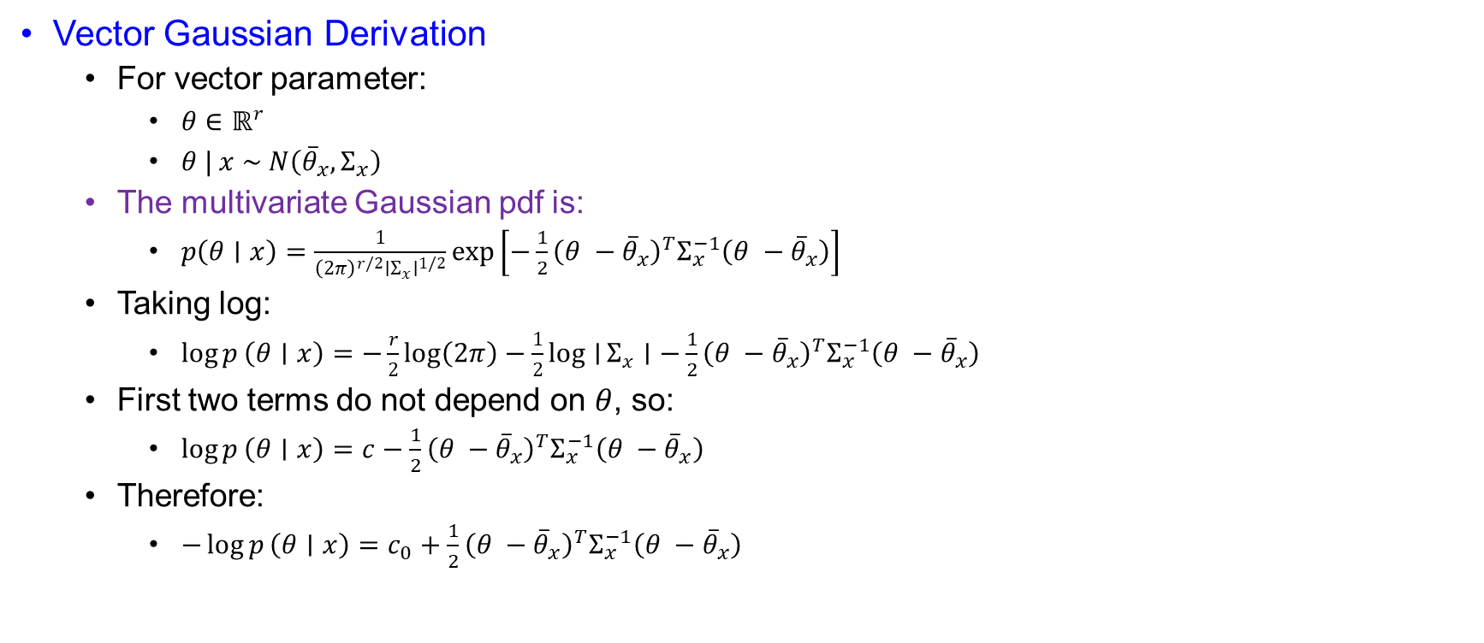
PCRB for Tracking or Filtering
Vector Gaussian Derivation
  For vector parameter:
    $θ∈ℝ^{r}$
    $θ | x \sim N\left({\overline{θ}}_{x},Σ_{x}\right)$
  The multivariate Gaussian pdf is:
    $p\left(θ∣x\right)=\frac{1}{{\left(2π\right)}^{r/2}∣Σ_{x}∣^{1/2}}\exp\left[−\frac{1}{2}{\left(θ −{\overline{θ}}_{x}\right)}^{T}Σ_{x}^{−1}\left(θ −{\overline{θ}}_{x}\right)\right]$
  Taking log:
    $\log{p}\left(θ∣x\right)=−\frac{r}{2}log⁡\left(2π\right)−\frac{1}{2}\log{∣}Σ_{x}∣−\frac{1}{2}{\left(θ −{\overline{θ}}_{x}\right)}^{T}Σ_{x}^{−1}\left(θ −{\overline{θ}}_{x}\right)$
  First two terms do not depend on $θ$, so:
    $\log{p}\left(θ∣x\right)=c−\frac{1}{2}{\left(θ −{\overline{θ}}_{x}\right)}^{T}Σ_{x}^{−1}\left(θ −{\overline{θ}}_{x}\right)$
  Therefore:
    $−\log{p}\left(θ∣x\right)=c_{0}+\frac{1}{2}{\left(θ −{\overline{θ}}_{x}\right)}^{T}Σ_{x}^{−1}\left(θ −{\overline{θ}}_{x}\right)$

Slide 22

PCRB for Tracking or Filtering
Fisher Information For Gaussian Posterior
  For Gaussian posterior:
    $−\log{p}\left(θ∣x\right)=c_{0}+\frac{1}{2}{\left(θ −{\overline{θ}}_{x}\right)}^{T}Σ_{x}^{−1}\left(θ −{\overline{θ}}_{x}\right)$
  First derivative:
    $∇_{θ}\left[−\log{p}\left(θ∣x\right)\right]=Σ_{x}^{−1}\left(θ −{\overline{θ}}_{x}\right)$
  Second derivative:
    $Δ_{θ}^{θ}\left[−\log{p}\left(θ∣x\right)\right]=Σ_{x}^{−1}$
  Therefore:
    $−Δ_{θ}^{θ}\log{p}\left(θ∣x\right)=Σ_{x}^{−1}$
  So:
    $J=𝔼\left\{Σ_{x}^{−1}\right\}$

Slide 23
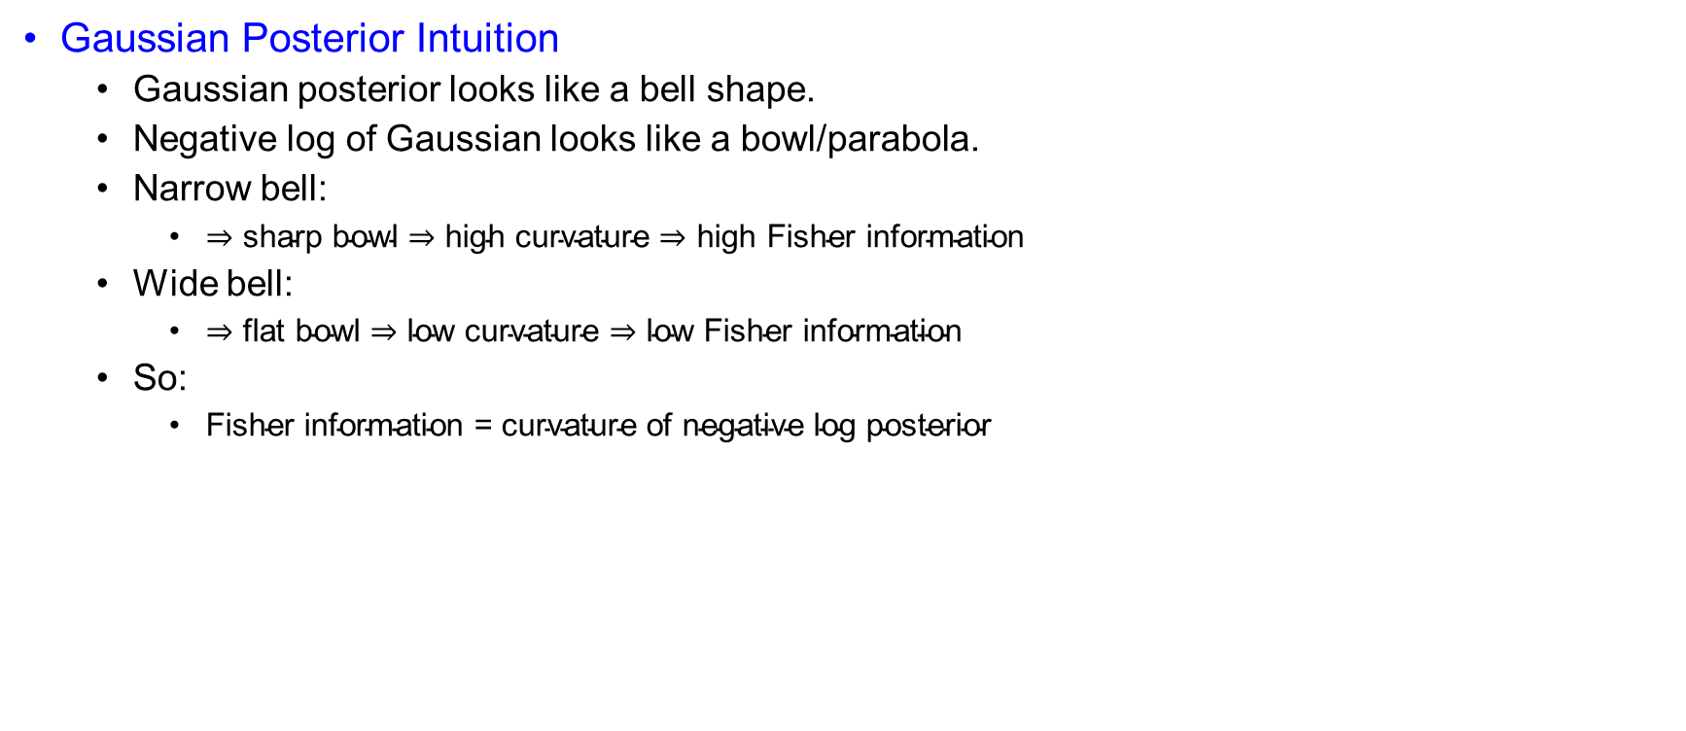
PCRB for Tracking or Filtering
Gaussian Posterior Intuition
  Gaussian posterior looks like a bell shape.
  Negative log of Gaussian looks like a bowl/parabola.
  Narrow bell:
    $⇒\text{sharp} \text{bowl}⇒\text{high} \text{curvature}⇒\text{high} \text{Fisher} \text{information}$
  Wide bell:
    $⇒\text{flat} \text{bowl}⇒\text{low} \text{curvature}⇒\text{low} \text{Fisher} \text{information}$
  So:
    $\text{Fisher} \text{information}\text{ = }\text{curvature} \text{of} \text{negative} \text{log} \text{posterior}$

Slide 24
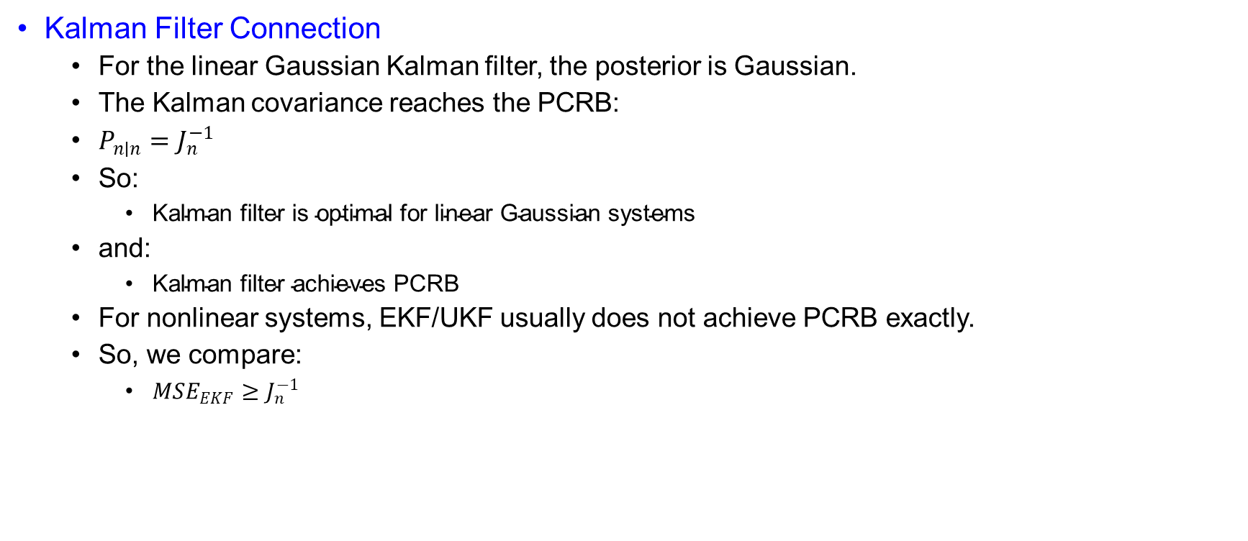
PCRB for Tracking or Filtering
Kalman Filter Connection
  For the linear Gaussian Kalman filter, the posterior is Gaussian.
  The Kalman covariance reaches the PCRB:
  $P_{n∣n}=J_{n}^{−1}$
  So:
    $\text{Kalman} \text{filter} \text{is} \text{optimal} \text{for} \text{linear} \text{Gaussian} \text{systems}$
  and:
    $\text{Kalman} \text{filter} \text{achieves} \text{PCRB}$
  For nonlinear systems, EKF/UKF usually does not achieve PCRB exactly.
  So, we compare:
    $MSE_{EKF}≥J_{n}^{−1}$

Slide 25
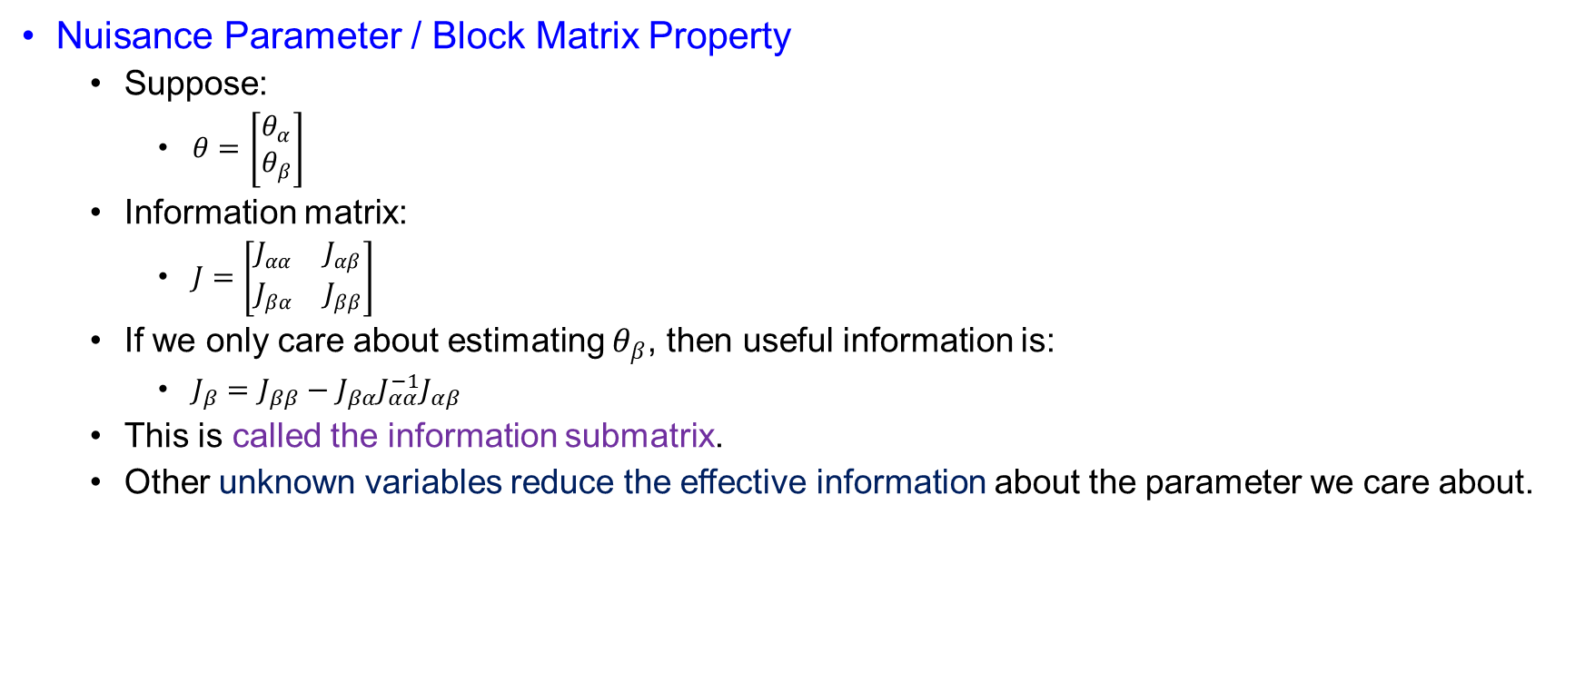
PCRB for Tracking or Filtering
Nuisance Parameter / Block Matrix Property
  Suppose:
    $θ=\left[\begin{matrix}θ_{α} \\ θ_{β}\end{matrix}\right]$
  Information matrix:
    $J=\left[\begin{matrix}J_{αα} & J_{αβ} \\ J_{βα} & J_{ββ}\end{matrix}\right]$
  If we only care about estimating $θ_{β}$, then useful information is:
    $J_{β}=J_{ββ}−J_{βα}J_{αα}^{−1}J_{αβ}$
  This is called the information submatrix.
  Other unknown variables reduce the effective information about the parameter we care about.

Slide 26
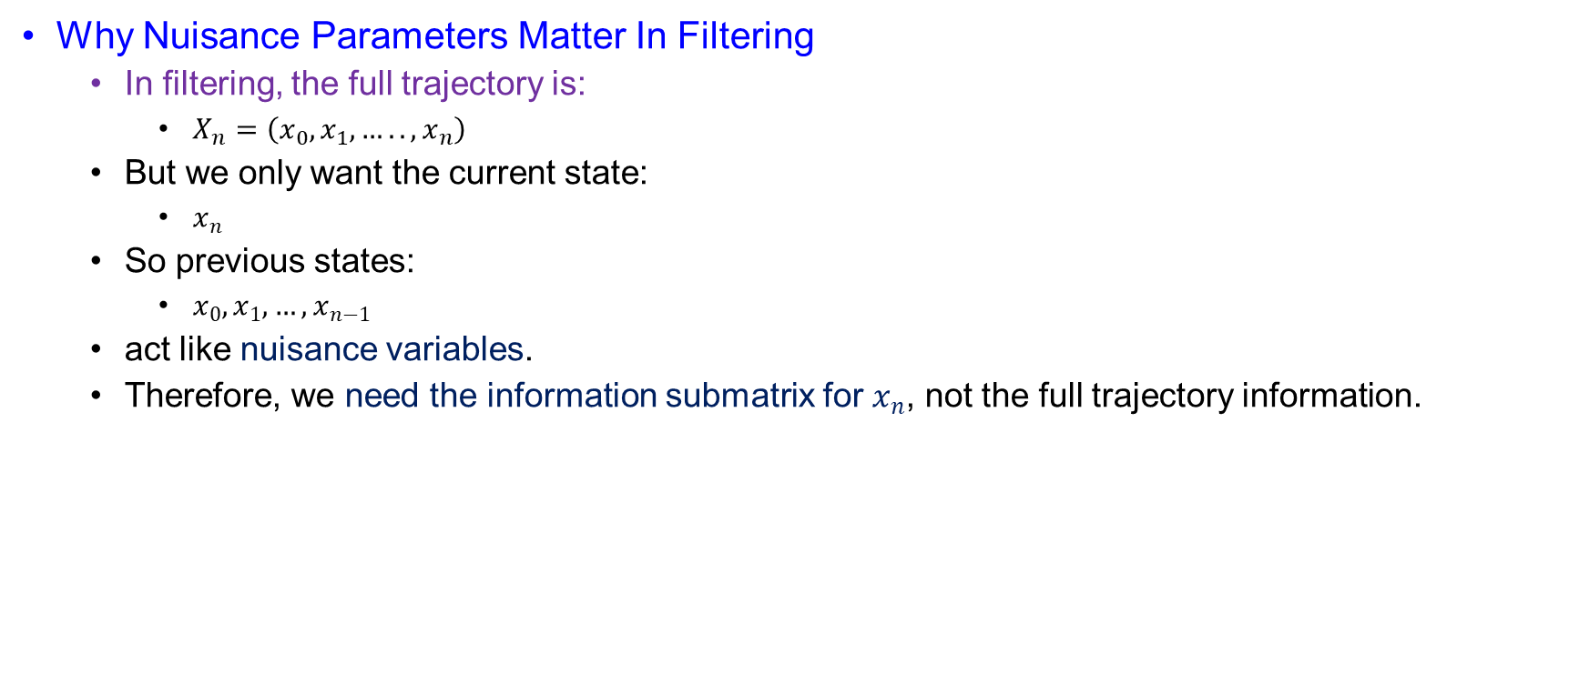
PCRB for Tracking or Filtering
Why Nuisance Parameters Matter In Filtering
  In filtering, the full trajectory is:
    $X_{n}=\left(x_{0},x_{1},…..,x_{n}\right)$
  But we only want the current state:
    $x_{n}$
  So previous states:
    $x_{0},x_{1},…,x_{n−1}$
  act like nuisance variables.
  Therefore, we need the information submatrix for $x_{n}$, not the full trajectory information.

Slide 27
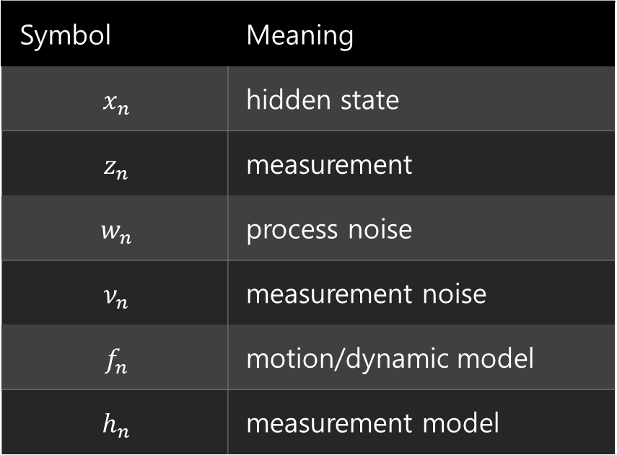
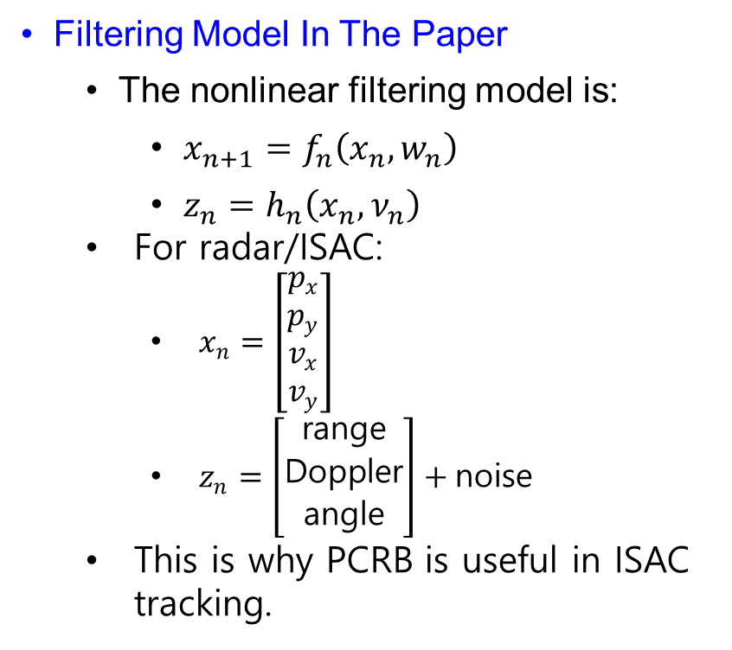
PCRB for Tracking or Filtering
Filtering Model In The Paper
  The nonlinear filtering model is:
    $x_{n+1}=f_{n}\left(x_{n},w_{n}\right)$
    $z_{n}=h_{n}\left(x_{n},ν_{n}\right)$
  For radar/ISAC:
    $x_{n}=\left[\begin{matrix}p_{x} \\ p_{y} \\ v_{x} \\ v_{y}\end{matrix}\right]$
    $z_{n}=\left[\begin{matrix}\text{range} \\ \text{Doppler} \\ \text{angle}\end{matrix}\right]+\text{noise}$
  This is why PCRB is useful in ISAC tracking.
Symbol | Meaning
$$x_{n}$$ | hidden state
$$z_{n}$$ | measurement
$$w_{n}$$ | process noise
$$ν_{n}$$ | measurement noise
$$f_{n}$$ | motion/dynamic model
$$h_{n}$$ | measurement model

Slide 28

PCRB for Tracking or Filtering
Recursive PCRB
  Recursive PCRB means:
    $\text{compute} J_{n} \text{time}\text{−}\text{step} \text{by} \text{time}\text{−}\text{step}$
    instead of building one huge information matrix for the whole trajectory.
  The key recursion is:
    $J_{n+1}=D_{n}^{22}−D_{n}^{21}{\left(J_{n}+D_{n}^{11}\right)}^{−1}D_{n}^{12}$
  This gives the posterior Fisher information for the next state.

Slide 29

PCRB for Tracking or Filtering
State And Measurement Sequences
  State trajectory:
    $X_{n}=\left(x_{0},x_{1},….,x_{n}\right)$
  Measurement sequence:
    $Z_{n} =\left(z_{1},z_{2},….,z_{n}\right)$
  Goal:
    $\text{Find} \text{information} \text{about} x_{n}$
  not the whole trajectory:
    $X_{n}$
  So PCRB uses information submatrix ideas.

Slide 30
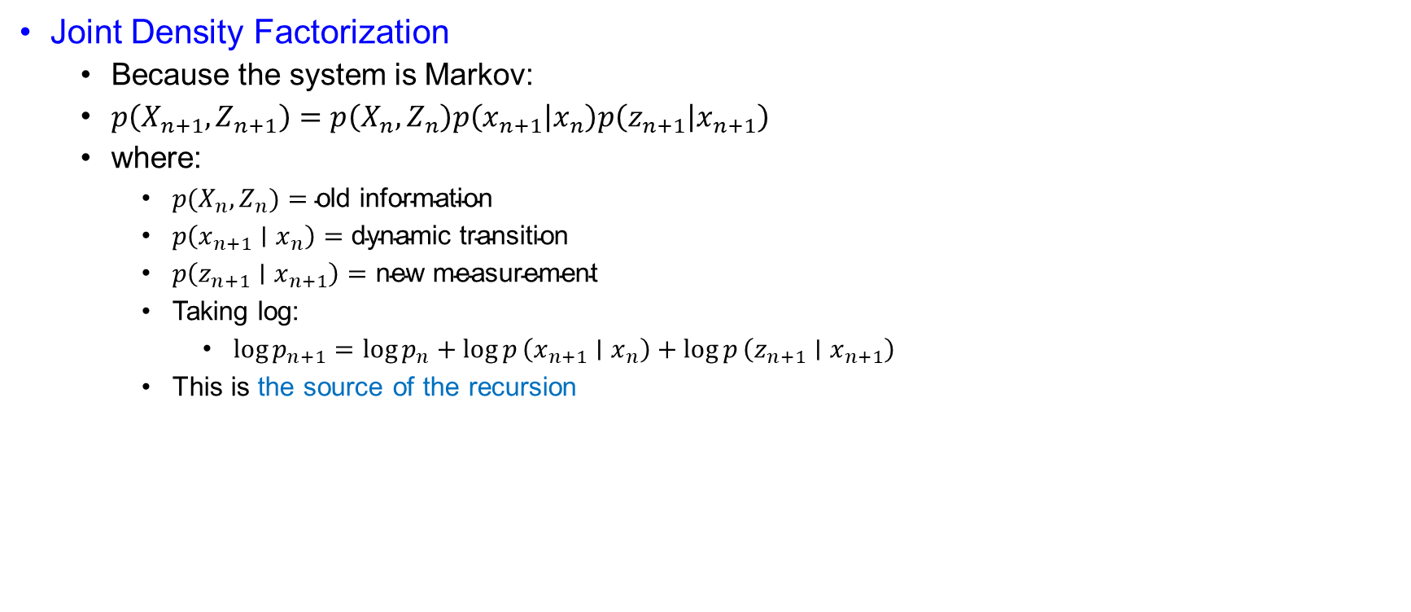
PCRB for Tracking or Filtering
Joint Density Factorization
  Because the system is Markov:
  $p\left(X_{n+1},Z_{n+1}\right)=p\left(X_{n},Z_{n}\right)p\left(x_{n+1} | x_{n}\right)p\left(z_{n+1} | x_{n+1}\right)$
  where:
    $p(X_{n},Z_{n})=\text{old} \text{information}$
    $p\left(x_{n+1}∣x_{n}\right)=\text{dynamic} \text{transition}$
    $p\left(z_{n+1}∣x_{n+1}\right)=\text{new} \text{measurement}$
    Taking log:
      $\log{p_{n+1}}=\log{p_{n}}+\log{p}\left(x_{n+1}∣x_{n}\right)+\log{p}\left(z_{n+1}∣x_{n+1}\right)$
    This is the source of the recursion

Slide 31
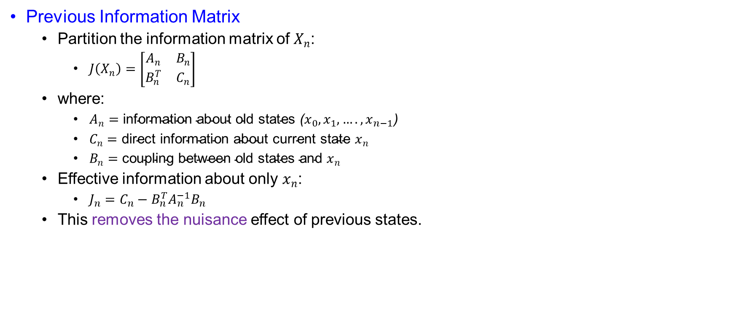
PCRB for Tracking or Filtering
Previous Information Matrix
  Partition the information matrix of $X_{n}$:
    $J\left(X_{n}\right)=\left[\begin{matrix}A_{n} & B_{n} \\ B_{n}^{T} & C_{n}\end{matrix}\right]$
  where:
    $A_{n}=\text{information} \text{about} \text{old} \text{states} \text{(}x_{0},x_{1},….,x_{n−1}\text{)}$
    $C_{n}=\text{direct} \text{information} \text{about} \text{current} \text{state} x_{n}$
    $B_{n}=\text{coupling} \text{between} \text{old} \text{states} \text{and} x_{n}$
  Effective information about only $x_{n}$:
    $J_{n}=C_{n}−B_{n}^{T}A_{n}^{−1}B_{n}$
  This removes the nuisance effect of previous states.

Slide 32
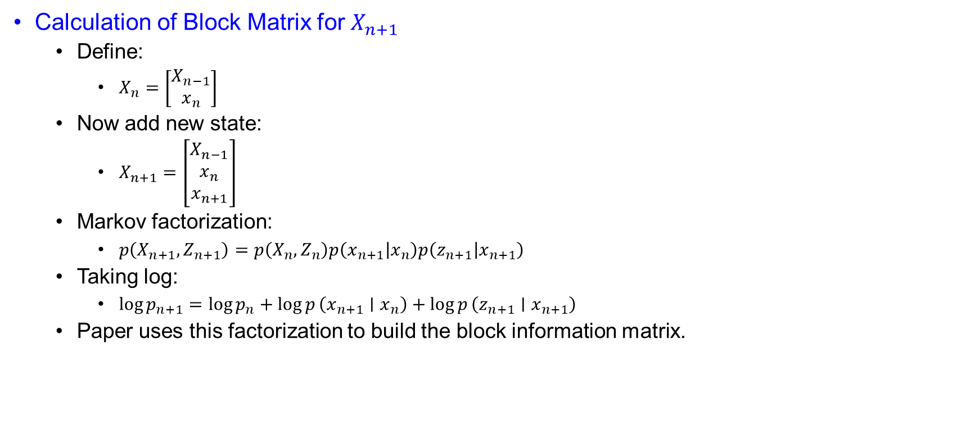
PCRB for Tracking or Filtering
Calculation of Block Matrix for $X_{n+1}$
  Define:
    $X_{n}=\left[\begin{matrix}X_{n−1} \\ x_{n}\end{matrix}\right]$
  Now add new state:
    $X_{n+1}=\left[\begin{matrix}X_{n−1} \\ x_{n} \\ x_{n+1}\end{matrix}\right]$
  Markov factorization:
    $p\left(X_{n+1},Z_{n+1}\right)=p\left(X_{n},Z_{n}\right)p\left(x_{n+1} | x_{n}\right)p\left(z_{n+1} | x_{n+1}\right)$
  Taking log:
    $\log{p_{n+1}}=\log{p_{n}}+\log{p}\left(x_{n+1}∣x_{n}\right)+\log{p}\left(z_{n+1}∣x_{n+1}\right)$
  Paper uses this factorization to build the block information matrix.

Slide 33

PCRB for Tracking or Filtering
Negative Hessian Contributions
  Posterior information matrix:
    $J\left(X_{n+1}\right)=𝔼\left[−Δ_{X_{n+1}}^{X_{n+1}}\log{p_{n+1}}\right]$
  Since:
    $X_{n+1}=\left[\begin{matrix}X_{n−1} \\ x_{n} \\ x_{n+1}\end{matrix}\right]$
  we take second derivatives with respect to these three blocks

Slide 34

PCRB for Tracking or Filtering
Contribution From Old Density
    $\log{p_{n}}=\log{p}\left(X_{n},Z_{n}\right)$
  It depends only on:
    $X_{n−1},x_{n}$
  not on:
    $x_{n+1}$
  So:
    $−Δ\log{p_{n}}=\left[\begin{matrix}A_{n} & B_{n} & 0 \\ B_{n}^{T} & C_{n} & 0 \\ 0 & 0 & 0\end{matrix}\right]$

Slide 35

PCRB for Tracking or Filtering
Contribution From Transition Density
  $\log{p}\left(x_{n+1}∣x_{n}\right)$
  This depends on:
    $x_{n},x_{n+1}$
  not directly on:
    $X_{n−1}$
  So:
    $−Δ\log{p}\left(x_{n+1}∣x_{n}\right)=\left[\begin{matrix}0 & 0 & 0 \\ 0 & D_{n}^{11} & D_{n}^{12} \\ 0 & D_{n}^{21} & D_{n,\text{trans}}^{22}\end{matrix}\right]$
  where:
    $D_{n}^{11}=𝔼\left[−Δ_{x_{n}}^{x_{n}}\log{p}\left(x_{n+1}∣x_{n}\right)\right]$
    $D_{n}^{12}=𝔼\left[−Δ_{x_{n}}^{x_{n+1}}\log{p}\left(x_{n+1}∣x_{n}\right)\right]$
    $D_{n}^{21}={\left(D_{n}^{12}\right)}^{T}$

Slide 36

PCRB for Tracking or Filtering
Contribution From Measurement Density
  $\log{p}\left(z_{n+1}∣x_{n+1}\right)$
  This depends only on:
    $x_{n+1}$
  So:
    $−Δ\log{p}\left(z_{n+1}∣x_{n+1}\right)=\left[\begin{matrix}0 & 0 & 0 \\ 0 & 0 & 0 \\ 0 & 0 & D_{n,\text{meas}}^{22}\end{matrix}\right]$

Slide 37

PCRB for Tracking or Filtering
Final Block Matrix
  Adding all three contributions:
  $J\left(X_{n+1}\right)=\left[\begin{matrix}A_{n} & B_{n} & 0 \\ B_{n}^{T} & C_{n}+D_{n}^{11} & D_{n}^{12} \\ 0 & D_{n}^{21} & D_{n}^{22}\end{matrix}\right]$
  where:
  $D_{n}^{22}=D_{n,\text{trans}}^{22}+D_{n,\text{meas}}^{22}$
  So:
  $D_{n}^{22}=𝔼\left[−Δ_{x_{n+1}}^{x_{n+1}}\log{p}\left(x_{n+1}∣x_{n}\right)\right]+𝔼\left[−Δ_{x_{n+1}}^{x_{n+1}}\log{p}\left(z_{n+1}∣x_{n+1}\right)\right]$

Slide 38

PCRB for Tracking or Filtering
Why Corner Block Is Zero
  Corner block:
    $\left(1,3\right)=0$
    because old states $X_{n−1}$and new state $x_{n+1}$are not directly connected.
  Markov relation:
    $X_{n−1}→x_{n}→x_{n+1}$
  So:
    $\frac{∂^{2}\log{p_{n+1}}}{∂X_{n−1}∂x_{n+1}}=0$
  $\text{Old} \text{states} \text{affect} x_{n+1} \text{only} \text{through} x_{n}$

Slide 39

PCRB for Tracking or Filtering
Definition Of $D$ Terms
  $D_{n}^{11}=𝔼\left[−Δ_{x_{n}}^{x_{n}}\log{p}\left(x_{n+1}∣x_{n}\right)\right]$
  $D_{n}^{12}=𝔼\left[−Δ_{x_{n}}^{x_{n+1}}\log{p}\left(x_{n+1}∣x_{n}\right)\right]$
  $D_{n}^{21}=𝔼\left[−Δ_{x_{n+1}}^{x_{n}}\log{p}\left(x_{n+1}∣x_{n}\right)\right]={\left(D_{n}^{12}\right)}^{T}$
  $D_{n}^{22}=𝔼\left[−Δ_{x_{n+1}}^{x_{n+1}}\log{p}\left(x_{n+1}∣x_{n}\right)\right]+𝔼\left[−Δ_{x_{n+1}}^{x_{n+1}}\log{p}\left(z_{n+1}∣x_{n+1}\right)\right]$

Slide 40

PCRB for Tracking or Filtering
Meaning Of $D$ Terms
  $D_{n}^{11}=\text{curvature} \text{with} \text{respect} \text{to} \text{old} \text{state} x_{n}$
  $D_{n}^{12},D_{n}^{21}=\text{coupling} \text{between} x_{n} \text{and} x_{n+1}$
  $D_{n}^{22}=\text{direct} \text{information} \text{about} x_{n+1}$
  So, the $D$ matrices collect information from:
    $\text{transition} \text{model}+\text{measurement} \text{model}$

Slide 41
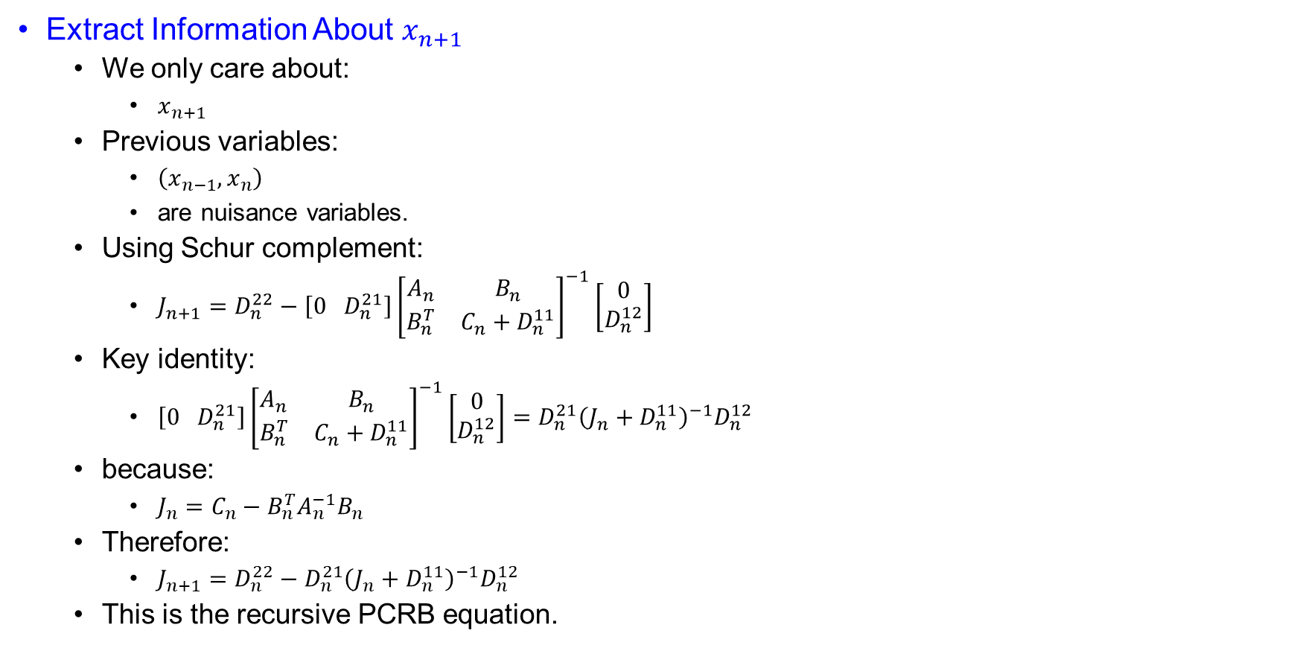
PCRB for Tracking or Filtering
Extract Information About $x_{n+1}$
  We only care about:
    $x_{n+1}$
  Previous variables:
    $\left(x_{n−1},x_{n}\right)$
    are nuisance variables.
  Using Schur complement:
    $J_{n+1}=D_{n}^{22}−\left[0 D_{n}^{21}\right]{\left[\begin{matrix}A_{n} & B_{n} \\ B_{n}^{T} & C_{n}+D_{n}^{11}\end{matrix}\right]}^{−1}\left[\begin{matrix}0 \\ D_{n}^{12}\end{matrix}\right]$
  Key identity:
    $\left[0 D_{n}^{21}\right]{\left[\begin{matrix}A_{n} & B_{n} \\ B_{n}^{T} & C_{n}+D_{n}^{11}\end{matrix}\right]}^{−1}\left[\begin{matrix}0 \\ D_{n}^{12}\end{matrix}\right]=D_{n}^{21}{\left(J_{n}+D_{n}^{11}\right)}^{−1}D_{n}^{12}$
  because:
    $J_{n}=C_{n}−B_{n}^{T}A_{n}^{−1}B_{n}$
  Therefore:
    $J_{n+1}=D_{n}^{22}−D_{n}^{21}{\left(J_{n}+D_{n}^{11}\right)}^{−1}D_{n}^{12}$
  This is the recursive PCRB equation.

Slide 42
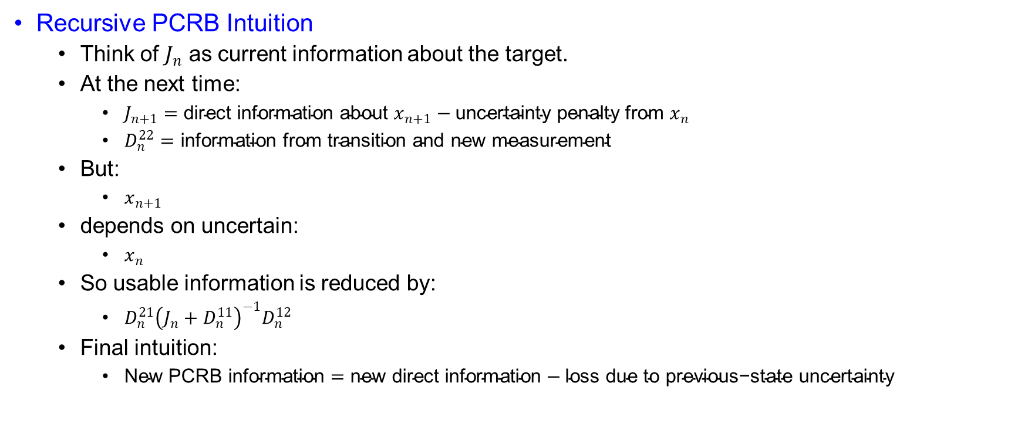
PCRB for Tracking or Filtering
Recursive PCRB Intuition
  Think of $J_{n}$ as current information about the target.
  At the next time:
    $J_{n+1}=\text{direct} \text{information} \text{about} x_{n+1}−\text{uncertainty} \text{penalty} \text{from} x_{n}$
    $D_{n}^{22}=\text{information} \text{from} \text{transition} \text{and} \text{new} \text{measurement}$
  But:
    $x_{n+1}$
  depends on uncertain:
    $x_{n}$
  So usable information is reduced by:
    $D_{n}^{21}{\left(J_{n}+D_{n}^{11}\right)}^{−1}D_{n}^{12}$
  Final intuition:
    $\text{New} \text{PCRB} \text{information}=\text{new} \text{direct} \text{information}−\text{loss} \text{due} \text{to} \text{previous}\text{−}\text{state} \text{uncertainty}$

Slide 43
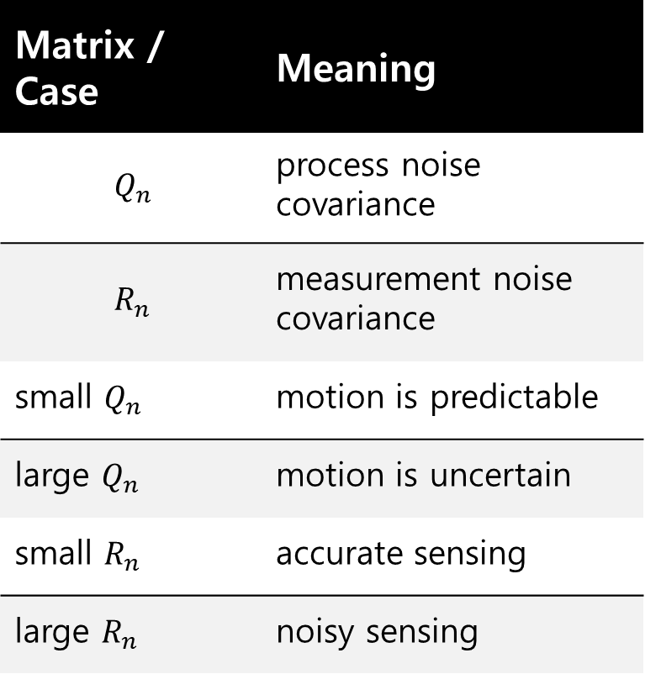

PCRB for Tracking or Filtering
Additive Gaussian Noise Case
  If:
    $x_{n+1}=f_{n}\left(x_{n}\right)+w_{n}$
    $z_{n}=h_{n}\left(x_{n}\right)+ν_{n}$
  with:
    $w_{n}\sim N\left(0,Q_{n}\right)$
    $ν_{n}\sim N\left(0,R_{n}\right)$
  then:
    $Q_{n}$
  and:
    $R_{n}$
  control PCRB.
Matrix / Case | Meaning
$$Q_{n}$$ | process noise covariance
$$R_{n}$$ | measurement noise covariance
small $Q_{n}$ | motion is predictable
large $Q_{n}$ | motion is uncertain
small $R_{n}$ | accurate sensing
large $R_{n}$ | noisy sensing

Slide 44
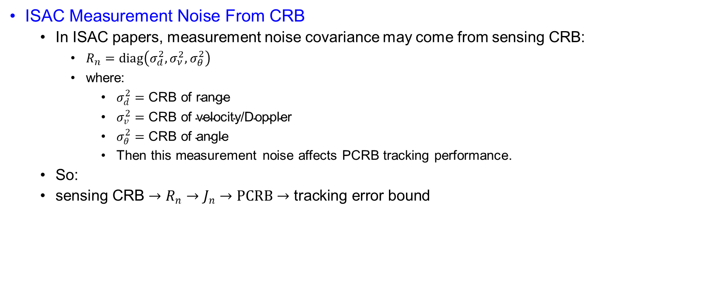
PCRB for Tracking or Filtering
ISAC Measurement Noise From CRB
  In ISAC papers, measurement noise covariance may come from sensing CRB:
    $R_{n}=diag\left(σ_{d}^{2},σ_{ν}^{2},σ_{θ}^{2}\right)$
    where:
      $σ_{d}^{2}=\text{CRB} \text{of} \text{range}$
      $σ_{v}^{2}=\text{CRB} \text{of} \text{velocity}\text{/}\text{Doppler}$
      $σ_{θ}^{2}=\text{CRB} \text{of} \text{angle}$
      Then this measurement noise affects PCRB tracking performance.
  So:
  $\text{sensing} \text{CRB}→R_{n}→J_{n}→PCRB→\text{tracking} \text{error} \text{bound}$

Slide 45

PCRB for Tracking or Filtering
Connection With Kalman Filter
  For linear Gaussian model:
    $x_{n+1}=F_{n}x_{n}+w_{n}$
    $z_{n}=H_{n}x_{n}+ν_{n}$
  Kalman covariance satisfies:
    $P_{n∣n}=J_{n}^{−1}$
  So PCRB is achieved.
  This means:
    $\text{Kalman} \text{filter} \text{reaches} \text{the} \text{theoretical} \text{lower} \text{bound}$
  for linear Gaussian systems.

Slide 46

PCRB for Tracking or Filtering
Connection With EKF
  For nonlinear model:
    $x_{n+1}=f_{n}\left(x_{n}\right)+w_{n}$
    $z_{n}=h_{n}\left(x_{n}\right)+ν_{n}$
  EKF approximates using Jacobians:
    $F_{n}=\frac{∂f_{n}}{∂x_{n}}$
    $H_{n}=\frac{∂h_{n}}{∂x_{n}}$
  Then we compare:
    $MSE_{EKF}≥J_{n}^{−1}$
  If EKF MSE is close to PCRB:
    $\text{tracking} \text{is} \text{good}$
  If EKF MSE is far above PCRB:
    $\text{estimator} \text{is} \text{inefficient} \text{or} \text{model} \text{is} \text{difficult}$

Slide 47
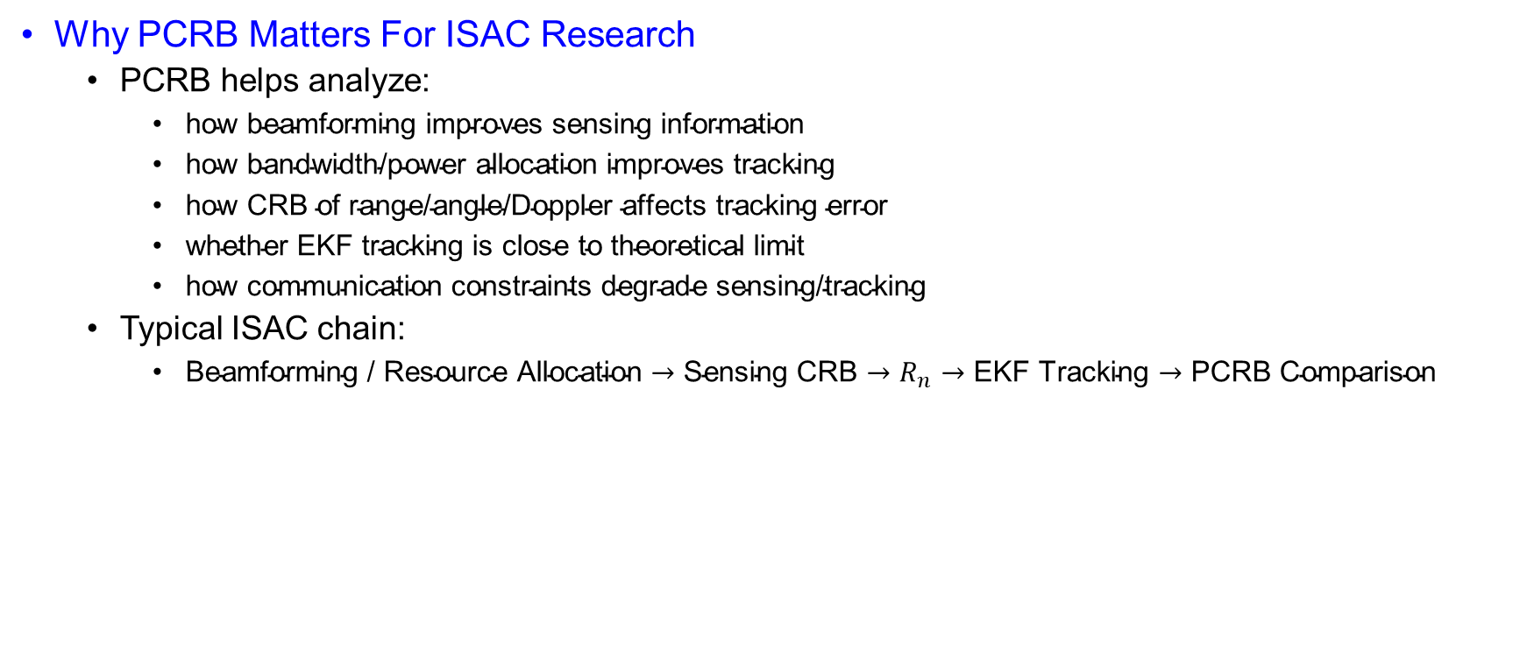
PCRB for Tracking or Filtering
Why PCRB Matters For ISAC Research
  PCRB helps analyze:
    $\text{how} \text{beamforming} \text{improves} \text{sensing} \text{information}$
    $\text{how} \text{bandwidth}\text{/}\text{power} \text{allocation} \text{improves} \text{tracking}$
    $\text{how} \text{CRB} \text{of} \text{range}\text{/}\text{angle}\text{/}\text{Doppler} \text{affects} \text{tracking} \text{error}$
    $\text{whether} \text{EKF} \text{tracking} \text{is} \text{close} \text{to} \text{theoretical} \text{limit}$
    $\text{how} \text{communication} \text{constraints} \text{degrade} \text{sensing}\text{/}\text{tracking}$
  Typical ISAC chain:
    $\text{Beamforming}\text{ / }\text{Resource} \text{Allocation}→\text{Sensing} \text{CRB}→R_{n}→\text{EKF} \text{Tracking}→\text{PCRB} \text{Comparison}$

Slide 48
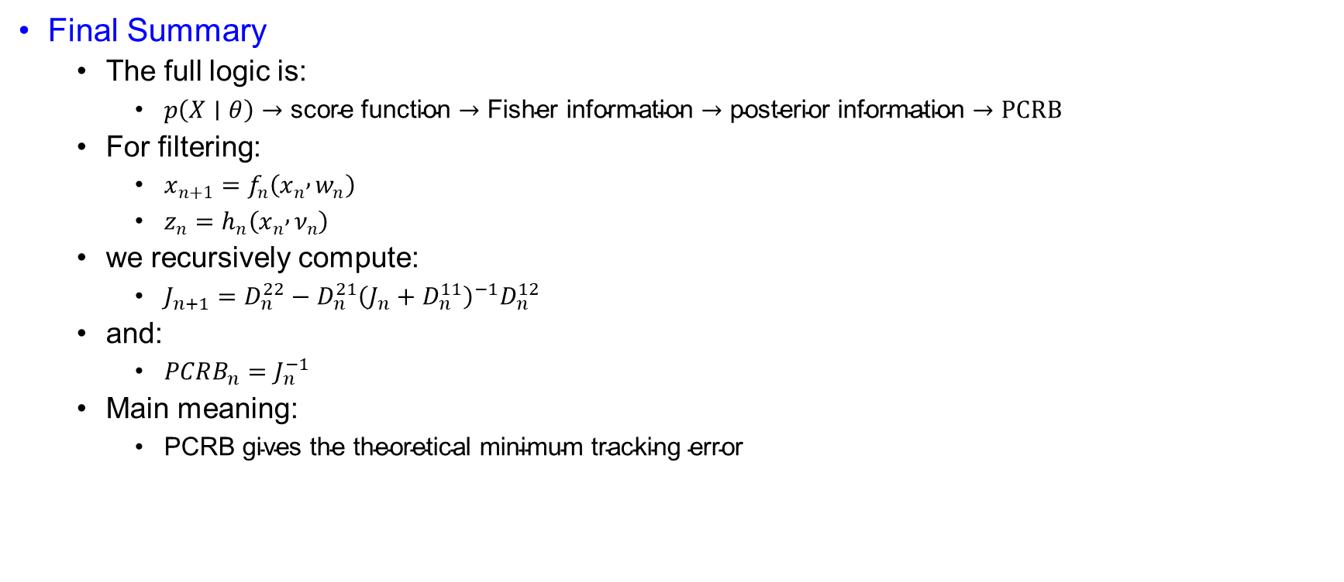
PCRB for Tracking or Filtering
Final Summary
  The full logic is:
    $p\left(X∣θ\right)→\text{score} \text{function}→\text{Fisher} \text{information}→\text{posterior} \text{information}→PCRB$
  For filtering:
    $x_{n+1}=f_{n}\left(x_{n} , w_{n}\right)$
    $z_{n}=h_{n}\left(x_{n} , ν_{n}\right)$
  we recursively compute:
    $J_{n+1}=D_{n}^{22}−D_{n}^{21}{\left(J_{n}+D_{n}^{11}\right)}^{−1}D_{n}^{12}$
  and:
    $PCRB_{n}=J_{n}^{−1}$
  Main meaning:
    $\text{PCRB} \text{gives} \text{the} \text{theoretical} \text{minimum} \text{tracking} \text{error}$

Slide 49
Power and Bandwidth Allocation for Multi-Target Tracking in Collocated MIMO Radar
Haowei Zhang; Binfeng Zong; Junwei Xie

Slide 50
Table of contents

Slide 51
Abstract
Paper Focus
  Power and Bandwidth Allocation for Multi-Target Tracking
  Collocated MIMO radar tracks multiple targets.
  Uses simultaneous multi-beam mode.
  Goal: improve target tracking accuracy.
  Key metric: weighted PCRLB.
Main Problem
  Limited Radar Resources
  Radar has limited:
    transmit power,
    bandwidth.
  Multiple targets need to be tracked simultaneously.
  Question: how much power and bandwidth should each target receive?

Slide 52
Abstract
Proposed Method
  Joint Power + Bandwidth Allocation
  Objective: minimize sum of weighted PCRLBs.
  Uses feedback from previous tracking cycle.
  Nonconvex problem is handled by:
    convex relaxation,
    cycle minimizer,
    two-stage convex optimization.
Key Takeaway
  Why This Paper Matters
  Better resource allocation gives better tracking.
  PCRLB links radar resources to tracking accuracy.
  Joint allocation performs better than uniform allocation.
  Useful foundation for dynamic ISAC target tracking.

Slide 53
Introduction
Motivation and Research Gap
  MIMO radar offers path diversity, flexible beam patterns, and multi-function operation.
  Existing radar resource allocation mainly focuses on power allocation.
  Most prior works consider static targets.
  For practical tracking, target motion must be considered.
  Bandwidth is also a critical but often ignored resource.
Proposed Direction
  This paper studies joint power and bandwidth allocation.
  Objective: minimize the sum of weighted PCRLBs.
  Uses feedback from the tracking cycle.
  Develops a closed-loop tracking/resource allocation framework.
  Solves the problem using convex relaxation + cyclical minimizer.

Slide 54
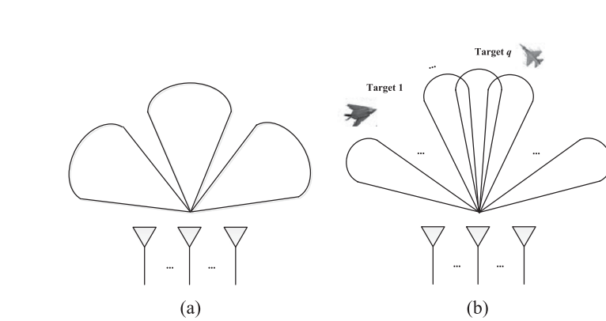
System Model
Figure 1. Illustration of multi-target tracking by simultaneous multi-beam mode. (a) Transmit beam pattern. (b) Receive beam pattern.

Slide 55
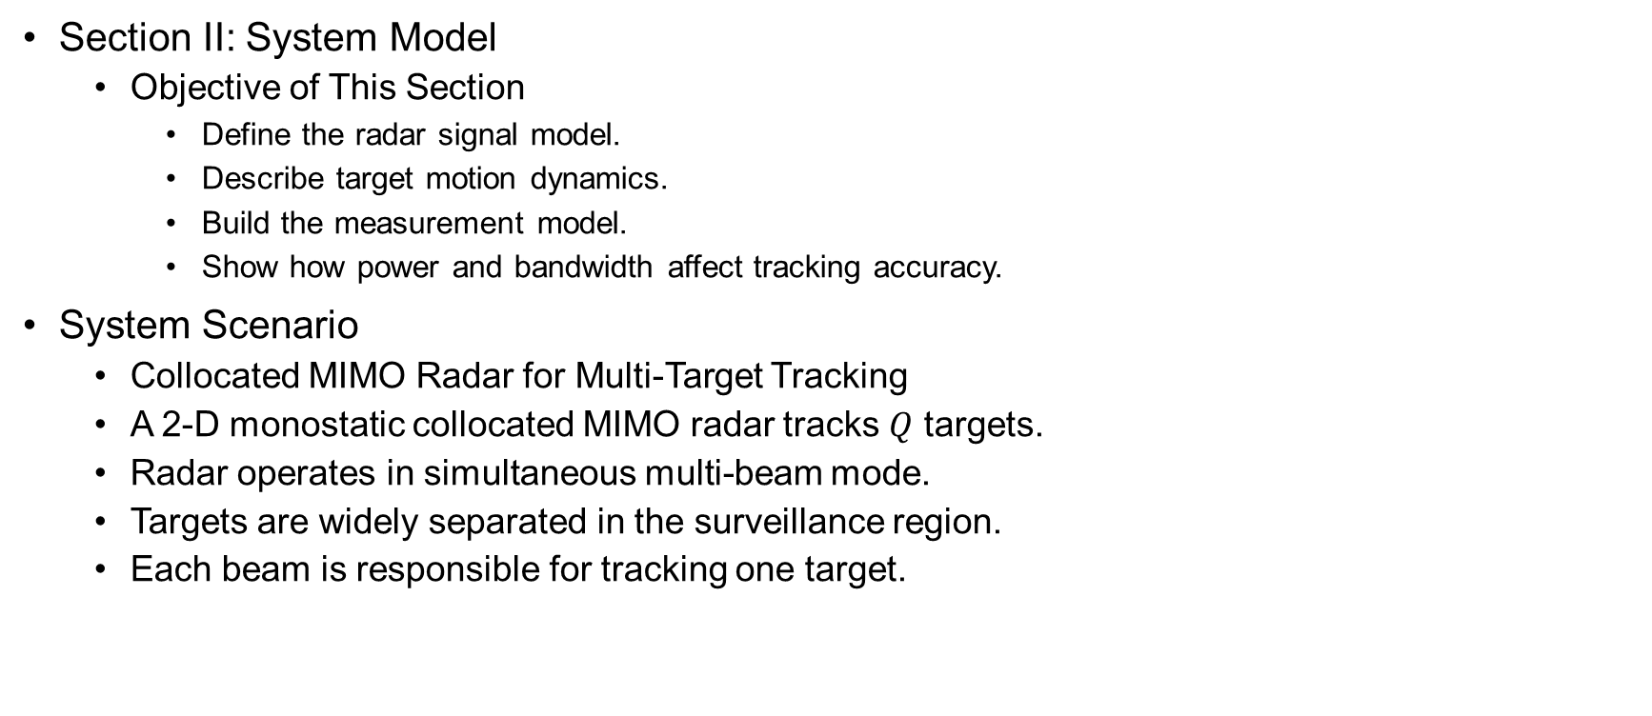
System Model
Section II: System Model
  Objective of This Section
    Define the radar signal model.
    Describe target motion dynamics.
    Build the measurement model.
    Show how power and bandwidth affect tracking accuracy.
System Scenario
  Collocated MIMO Radar for Multi-Target Tracking
  A 2-D monostatic collocated MIMO radar tracks $Q$ targets.
  Radar operates in simultaneous multi-beam mode.
  Targets are widely separated in the surveillance region.
  Each beam is responsible for tracking one target.

Slide 56


System Model
Transmit Signal Model
  For the $q$-th target at the $k$-th interval:
    $s_{t,k}^{q}\left(t\right)=\sqrt{P_{k}^{q}}{\tilde{s}}_{k}^{q}\left(t\right)exp⁡\left(−j2πf_{c}t\right)$
    $P_{k}^{q}$: allocated transmit power.
    ${\tilde{s}}_{k}^{q}\left(t\right)$: complex envelope.
    $f_{c}$: carrier frequency.
    $P_{k}^{q}→\text{affects} \text{received} \text{echo} \text{strength}$
Symbol | Meaning
Superscript $q$ | $q−th$ target, $q∈\left\{1,..,Q\right\}$
Subscript $k$ | $k−$th sample/tracking interval
$$q$$ | $q$-th target
$$k$$ | $k$-th tracking/sample interval
$$x_{k}^{q}$$ | Target state vector
$$P_{k}^{q}$$ | Allocated power
$$β_{k}^{q}$$ | Allocated bandwidth
$$τ_{k}^{q}$$ | Time delay
$$ν_{k}^{q}$$ | Doppler shift
$$z_{k}^{q}$$ | Measurement vector

Slide 57

System Model
Effective Bandwidth
  $∣β_{k}^{q}∣^{2}=\frac{\int{f^{2}}∣{\tilde{s}}_{k}^{q}\left(f\right)∣^{2}df}{\int{∣}{\tilde{s}}_{k}^{q}\left(f\right)∣^{2}df}$
    $β_{k}^{q}$ represents effective bandwidth.
    Larger bandwidth improves range estimation accuracy.
    Bandwidth is a key radar resource.
    $\text{Larger} \text{bandwidth}⇒\text{better} \text{range} \text{accuracy}$
Effective Time Duration
  $∣T_{k}^{q}∣^{2}=\frac{\int{t^{2}}∣{\tilde{s}}_{k}^{q}\left(t\right)∣^{2}dt}{\int{∣}{\tilde{s}}_{k}^{q}\left(t\right)∣^{2}dt}$
    $T_{k}^{q}$ represents effective time duration.
    It affects Doppler / radial velocity estimation.
    Longer observation duration improves velocity estimation.
    $\text{Larger} T_{k}^{q}⇒\text{better} \text{velocity} \text{accuracy}$

Slide 58

System Model
Received Signal Model
  $s_{r,k}^{q}\left(t\right)≈h_{k}^{q}\sqrt{{α_{k}^{q}P}_{t,k}^{q}}{\tilde{s}}_{k}^{q}\left(t−τ_{k}^{q}\right)exp⁡\left(−j2πν_{k}^{q}t\right)+n_{k}^{q}\left(t\right)$
    $h_{k}^{q}$: target reflection coefficient.
    $α_{k}^{q}$: path-loss attenuation.
    $τ_{k}^{q}$: time delay → range information.
    $ν_{k}^{q}$: Doppler shift → velocity information.
    $n_{k}^{q}\left(t\right)$: complex Gaussian noise.

Slide 59

System Model
Information Extracted from Echo
  The received echo contains:
    Radar echo → range, velocity, angle information
Echo Parameter | Physical Meaning
Time delay $τ_{k}^{q}$ | Target range
Doppler shift $ν_{k}^{q}$ | Radial velocity
Reflection coefficient $h_{k}^{q}$ | Target reflectivity
Received power | Measurement quality

Slide 60

System Model
Target State Model
  The target follows a constant acceleration model:
    $x_{k}^{q}=F^{q}x_{k−1}^{q}+w_{k −1}^{q}$
  State vector:
    $x_{k}^{q}={\left[x_{k},y_{k},{\dot{x}}_{k},{\dot{y}}_{k},{\ddot{x}}_{k},{\ddot{y}}_{k}\right]}^{T}$
  The state includes:
    Position
    Velocity
    Acceleration
  State Transition Matrix
    $F^{q}=\left[\begin{matrix}1 & T_{s} & \frac{T_{s}^{2}}{2} \\ 0 & 1 & T_{s} \\ 0 & 0 & 1\end{matrix}\right] ⨂{I_{2}}$
    $T_{s}:sample interval.$
    $I_{2} :2−D motion in x−and y−coordinates$
    $⨂{:} Kronecker product$
  $F^{q}→predicts next target state$

Slide 61

System Model
Process Noise Model
  $w_{k−1}^{q}\sim N\left(0,Q^{q}\right)$
  $Q^{q}=k^{q}\left[\begin{matrix}\frac{T_{s}^{5}}{20} & \frac{T_{s}^{4}}{8} & \frac{T_{s}^{3}}{6} \\ \frac{T_{s}^{4}}{8} & \frac{T_{s}^{3}}{3} & \frac{T_{s}^{2}}{2} \\ \frac{T_{s}^{3}}{6} & \frac{T_{s}^{2}}{2} & T_{s}\end{matrix}\right]⨂{I_{2}}$
  Process noise represents motion uncertainty
  $k^{q}$ controls the process noise intensity
  Larger $k^{q}$ means target motion is harder to predict

Slide 62

System Model
Measurement Model
  $z_{k}^{q}=h\left(x_{k}^{q}\right)+ν_{k}^{q}$
  Where:
    $h\left(x_{k}^{q}\right)={\left[r_{k},{\dot{r}}_{k},θ_{k}\right]}^{T}$
  Radar measures
    $r_{k}:$ range
    $\dot{r_{k}}$ : radial velocity
    $θ_{k}:$ azimuth angel

Slide 63

System Model
Nonlinear Measurement Function
  $r_{k}= \sqrt{x_{k}^{2}+y_{k}^{2}}$
  $\dot{r_{k}}= \frac{{\dot{x}}_{k}x_{k}+{\dot{y}}_{k}y_{k}}{r_{k}}$
  $θ_{k}=\arctan\left(\frac{y_{k}}{x_{k}}\right)$
  The measurement function is nonlinear.
  Therefore, tracking usually requires nonlinear filtering methods such as:
    EKF
    UKF
    SCKF

Slide 64

System Model
Measurement Noise Covariance
  $ν_{k}^{q}\sim N\left(0,R_{k}^{q}\right)$
  $R_{k}^{q}=diag\left(σ_{r,k}^{2q},σ_{\dot{r},k}^{2q},σ_{θ,k}^{2q}\right)$
  Measurements uncertainty is represented by:
    Range error covariance
    Radial velocity error variance
    Angle error variance
CRLB of Measurement Accuracy
  $σ_{r,k}^{2q}∝{\left(α_{k}^{q}P_{k}^{q}{\left|h_{k}^{q}\right|}^{2}{\left|β_{k}^{q}\right|}^{2}\right)}^{−1}$
  $σ_{\dot{r},k}^{2q}∝{\left(α_{k}^{q}P_{k}^{q}{\left|h_{k}^{q}\right|}^{2}{\left|T_{k}^{q}\right|}^{2}\right)}^{−1}$
  $σ_{θ,k}^{2q}∝{\left(\frac{α_{k}^{q}P_{k}^{q}{\left|h_{k}^{q}\right|}^{2}}{B_{w}}\right)}^{−1}$

Slide 65

System Model
$\text{Key} \text{Interpretation}$
  $\text{Power} \text{effect}$
    $P_{k}^{q}↑⇒\text{measurement} \text{error} \text{decreases}$
  $\text{Bandwidth} \text{effect}$
    $β_{k}^{q}↑⇒\text{range} \text{error} \text{decreases}$
  $\text{Time} \text{duration} \text{effect}$
    $T_{k}^{q}↑⇒\text{velocity} \text{error} \text{decreases}$
  $\text{Target} \text{reflection} \text{effect}$
    $∣h_{k}^{q}∣^{2}↑⇒\text{measurement} \text{quality} \text{improves}$
This section builds the chain:
  Power + Bandwidth + Measurement Noise $→$ CRLB$→$PCRLB$→$Tracking Accuracy

